Slide 1


Foundations for
Meeting Needs
sponsored by the
New York State
Office of Children and Family Services
through a training and
administrative services agreement with the
Research Foundation for SUNY
SUNY Buffalo State
Center for Development of Human Services

Slide 2
Session 1
Meeting Needs: Fostering to Achieve Outcomes

Slide 3
Purpose of Session 1:
To be effective in their role, foster/adoptive parents must understand the broad outcomes that they are to achieve. They should also recognize how those outcomes relate to their everyday lives as foster/adoptive parents.
This session focuses on synthesizing a child welfare philosophy with the foster/adoptive parent’s role and demonstrates how developing a relationship by using the helping skills can achieve the Five Foster/Adoptive Family Role Outcomes articulated in the child welfare philosophy

Slide 4
Warm up Activity
Review each of 12 skills
Identify skill that is your greatest strength
Write how you demonstrate the strength
Place sticky note on matching 12 skill
Session1 Section A #3

Slide 5
Five Foster/Adoptive Family
Role Outcomes
Safety
Child Development
Emotional Security & Attachment
Reunification/Adoption
Independent Living
Session1 Section C #1

Slide 6
Patchwork Quilt Directions
Work in small groups
Create a patch for each Outcome
Work together on each patch
Finish the Quilt in 15 minutes
Session 1 Section C #3

Slide 7



The Three Building Blocks of a Helping Relationship
Empathy
Genuineness
Respect
Session 1 Section C #3

Slide 8
SYMPATHY
VS.
EMPATHY
Session 1 Section E #1

Slide 9
SYMPATHY
Involves sharing our thoughts and feelings of sorrow or distress with another person about his experience.
VS.
EMPATHY
Session 1 Section E #1

Slide 10
SYMPATHY
Involves sharing our thoughts and feelings of sorrow or distress with another person about his experience.
VS.
EMPATHY
Reaching out to
understand the feelings and meaning an experience has for
the other person
Session 1 Section E #1

Slide 11
EGR Practice Directions
Work in small groups
Use Handout 4
Take 3 minute turn as foster parent
Observer: give 2 minutes
of feedback
(Use worksheet 1 as guide)
Session 1 Section H #2

Slide 12
Session 2
Meeting Needs: Using the Helping Skills to Build Relationships

Slide 13
Purpose of Session 2:
Session 2 builds upon Session 1 by developing participants’ understanding and use of the interpersonal helping skills that are practice together with the three building blocks of a helping relationship.
As a result of learning how to consciously use the nonverbal and verbal helping skills, foster and adoptive parents will be better able to build and maintain the kinds of interpersonal relationships necessary to achieve the Five Foster/Adoptive Family Role Outcomes.

Slide 14
You feel….
You sound…
You look…
You seem…
Session 2 Activity B #2

Slide 15
How did you know
what particular
emotion your partner was trying to communicate?
Session 2 Activity B #4

Slide 16
Nonverbal Helping Skills
Environment
Body and Face
Voice
Session 2 Activity C #1

Slide 17
Nonverbal Skills Practice Directions
Work in groups of three
Use Handout 2
Take turns as child, foster parent, and observer
Observer: give feedback
Session 2 Activity D #2

Slide 18
Verbal Helping Skills
Questioning
Concreteness
Reflection
(Content & Feeling)
Session 2 Activity E #1

Slide 19
OPEN VS. CLOSED QUESTIONS
What did you do when you realized that the teacher was talking to you?
Session 2 Activity E #3

Slide 20
OPEN VS. CLOSED QUESTIONS
So, do you like baseball or basketball?
Session 2 Section E #3

Slide 21
OPEN VS. CLOSED QUESTIONS
What were some of the things you did during your home visit?
Session 2 Activity E #3

Slide 22
OPEN VS. CLOSED QUESTIONS
Did you attend the parenting class?
Session 2 Activity E #3

Slide 23
Reflections are concise restatements of the content or feeling (or both) of the person’s immediate past message
Session 2 Activity E #9

Slide 24
Effective Reflective Listening
Understand and identify the feelings and emotions being expressed.
Accurate represent the content of what is said by paraphrasing.
Watch for nonverbal signals that can be used to identify feelings.
Personalize our own messages to another by using the word “you” or his/her name.
Session 2 Activity E #12

Slide 25
Verbal Skills Practice Directions
Work in groups of 3
Use Handout 3 guidelines
Take turns as the foster parent
Observer: give feedback
Session 2 Activity G #2

Slide 26
Session 3
Meeting Needs: Promoting Child Development

Slide 27

Through the of a child:
Take turns describing to your partner what the object represents or looks like to a child of the age group shown on your sticky note.
Complete the sentence, “What I see is something that_________________”
Take turns guessing which age group your partner is after the TWO objects are described.
Session 3 Activity B #1

Slide 28
Child Development Across the Five Domains
Physical Development
Emotional Development
Social Development
Mental Development
Moral Development
Session 3 Activity B #3

Slide 29
Ages/Stages Directions
Volunteer reads cards
Group sorts cards into 5 piles by age/stage where behavior is most characteristic
Reporter posts cards on newsprint
(10 minutes)
Session 3 Activity C

Slide 30
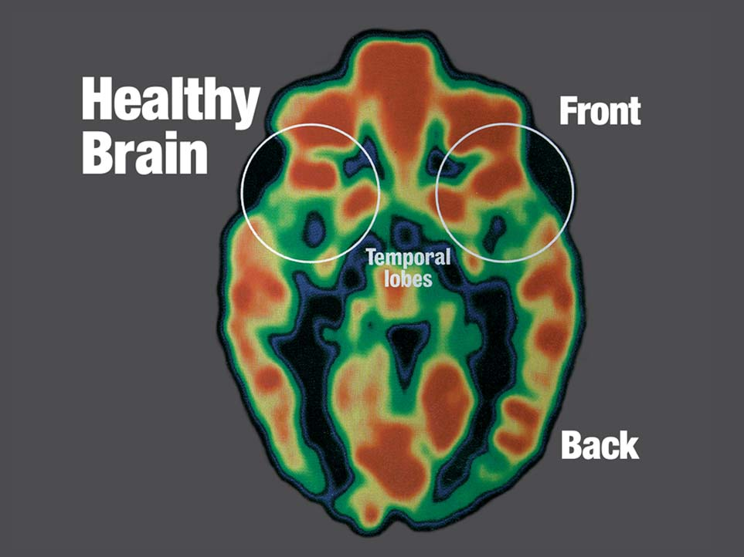
Session 3 Activity D #6

Slide 31
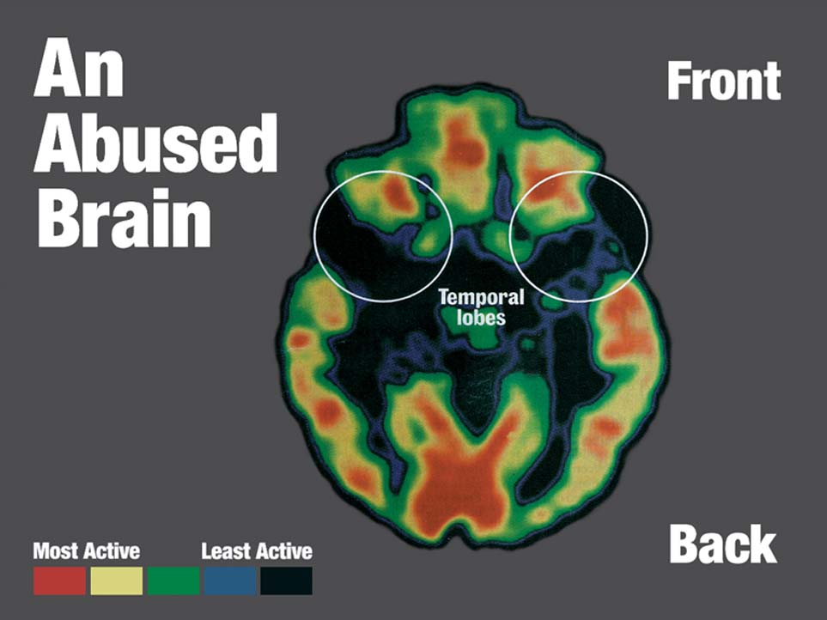
Session 3 Activity D #6

Slide 32
Abuse/Neglect Damage the Brain
CORTEX
HIPPOCAMPUS
AMYGDALA
Session 3 Activity D #7

Slide 33
Overwhelming stress early in life alters the production of the chemical messengers in the brain that affect mood and behavior
Session 3 Activity D #8

Slide 34
Case Study Practice
Work with a partner
Identify child’s present abilities
Find a match for present abilities in Child Development Guide.
Select parenting ideas to meet child’s developmental needs.
Discuss idea with partner
(15 minutes)
Session 3 Activity F #2

Slide 35
Session 4
Meeting Needs: Supporting Emotional Security and Attachment

Slide 36
Positive Working Model
I am:
worthwhile and wanted
safe
capable
Session 4: Activity B # 4

Slide 37
Positive Working Model
Adults are:
available
responsible
here to meet my needs
trustworthy

Slide 38
Negative Working Model
I am:
worthless
unsafe
powerless
angry and unloved
Session 4: Activity B # 4

Slide 39
Negative Working Model
Adults are:
irresponsible
unreliable
untrustworthy
rejecting
Session 4: Activity B # 6

Slide 40
Foster Parent Reactions
☹ Impulse to reject the child
☹ Feelings of powerlessness
☹ Emotional withdrawal and
depression
☹ Good/bad parent split
Session 4 Activity C #24

Slide 41
What behaviors push
your buttons?
Session 4 Activity D #2

Slide 42
“Consequences
with
Empathy”

Slide 43
Barbie Case Study Directions
Divide into small groups
Use Handout 4 and Worksheet 1
Answer questions about Barbie
Session 4 Activity E #15

Slide 44
Session 5
Meeting Needs: Helping Children Grieve

Slide 45
Peer Assisted Review
Explain the word or idea
Discuss how this applies to the loss and separation experience of children in care
Write down questions or comments (1 per sticky note)
(10 minutes)
Session 5 Activity C #2

Slide 46
When Assessing Children’s Grief…..
Does the child speak about his parents and/or siblings?
What does the child say or do before and after visits?
How did the child behave before coming
into care?
Are the child’s behaviors different now?
Are difficult behaviors easing or getting worse?
Session 5 Activity C #5

Slide 47
Four Critical Informational Needs of Grieving Children
“You will be taken care of, and you are not alone.”
“You are not the cause of the separation.”
“You can always ask whatever questions you may want to ask.”
“This is what must happen before you can go home.”
Session 5 Activity D #2

Slide 48
When Talking With a Child
About the Reasons for Placement…
 Share all available concrete information.
 Use the nonverbal and verbal helping skills listen and ask questions.
 Do not condemn or judge the parent.
 If there is something the parent must do, tell the child what it is.
 Try to find answers-or admit you have none, if that is the case.
Session 5 Activity D #6

Slide 49
Talking About Loss Activity Directions
Use guidelines from Handout 3
“Give permission” and “normalize the emotion”
Talk with Pi about loss and separation
(10 minutes)
Session 5 Activity E #1

Slide 50
Session 6
Meeting Needs:
Supporting Reunification Through Visits

Slide 51
Case Study Activity
Work in groups of three
Use Handouts 4 and 5
Complete Worksheets 2,3, and 4.
(7 minutes each)
Session 6 Activity E #3

Slide 52
Session 7
Meeting Needs:
Providing Safety

Slide 53
Safety Factors
A central listing of conditions and behaviors and their effects on children that are used by caseworkers to assess family situations
Session 6 Activity E #5

Slide 54
Protecting Factors
Strengths, attributes, circumstances, abilities, and/or resources that the parent or caregiver uses to promote and support the child’s safety in the currently living arrangement
Session 6 Activity E #6

Slide 55
Safety Intervention
Reponses to protect a child and control any immediate danger to the child.
The actions are intended to be temporary.
Session 6 Activity E #7

Slide 56
Safety Concerns in the Foster Home:
Child
Other members of
the foster family
Community at large
Session 6 Activity E #1

Slide 57
Protecting Factors
A strength that a foster parent uses to keep a child, the foster family, and/or the larger community around them safe.
Session 6 Activity E #3

Slide 58
Protecting Factors
a foster home that meets all the applicable licensing requirements.
Foster parents who have appropriate resources and supports to meet a child’s needs.
Foster parents who have been appropriately trained to meet a child’s special needs.
Session 6 Activity E #3

Slide 59
Safety Message
The things we say and the information we give children about their right to be safe.
Session 6 Activity F #1

Slide 60
Safety Message Role Play
Divide into Groups of three
Using Handout 5 as a guide
Take on a role: child, foster parent or observer
Observers give feedback
(8 minutes)
Session 7Activity F #5

Slide 61
Session 8
Meeting Needs:
Preparing Youth for Independent Living

Slide 62
Assessment is the process of obtaining and
then analyzing information before making a decision.
Session 8 Activity C #1

Slide 63
Four Areas of Assessment
Basic Skills: reading, writing, math
Employment skills: ability to find and keep a job
Social Relationship Skills: ability to get along with others
Daily Living Skills: money management, cooking, personal care, laundry, transportation needs
Session 8 Activity C #3

Slide 64
Youth Assessment Directions
Draw 2 columns on a sheet of paper
At left: write “Information Needed”
At right: write “How Obtained”
Record responses
(10 minutes)
Session 8 Activity C #4

Slide 65
The Six Steps of Problem Solving
Set the stage.
Define the problem.
Brainstorm possible solutions.
Choose a solution.
Put the solution to work.
Evaluate the solution.
Session 8 Activity D #3

Slide 66
Teaching Steps Activity
Individually:
Identify the steps necessary
Write each step on a separate “sticky” note
As a group:
Place the “sticky” notes in correct order
Discard any duplicates
(10 minutes)
Session 8 Activity E #2

Slide 67
Emotional Issues of Youth
Loss and Separation
Identity
Survivor Guilt
Making Peace with the Past

Slide 68
Session 9
Meeting Needs:
Creating Partnerships and Working As A Team

Slide 69
Social Contracting Directions
Break into groups of three
Use Handout 5
Take turns being the foster parent
Practice using the eight steps to provide feedback
Observers give feedback
Session 9 Activity G #3

Slide 70
COMPASS Review Directions
Identify a behavior or information from each session that you used to work toward any of the Five Foster/Adoptive Role Outcomes
Write on newsprint, pass newsprint to the right
Repeat the process for each newsprint
(2 minutes per newsprint)

